Slide 1
Restorative Justice Practices and Relationships in 3 Rural High Schools
Continuation Request and Annual Report Annual Report for NNR-19-349T
NNR-19-349TAANovember 8, 2022- SJSD Board Meeting
Tasha Seneca Keyes, PhD, MSW
Aundrea Dilanchian, MSW, PhD Student
Irina Riverman, MSW, CSW
Nicole Plumb, MSW, MPH
Notes:
Good Afternoon, my name is Tasha Seneca Keyes, I am Haudenosaunee- from the Seneca Nation of Indians in western NY. When I conducted this study in your school district I was an assistant professor at the University of Utah in the College of Social Work. I have since moved to Cal State San Marcos. I am also a former school social worker.
I had several research assistants Aundrea Dilanchian, Irina Riverman, and Nicole Plumb who helped me with data collection, and analysis who I want to thank. The title of this study-is Restorative Justice Practices and Relationships in three rural High Schools.

Slide 2
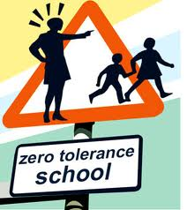
Discipline in U.S. Public Schools – exclusionary, social control
(Gregory, Skiba, & Noguera, 2010)
Increase student defiance
Decrease Sense of Belonging
Diminished capacity to engage in school community
Disproportionality affects students of color and students with disabilities.
Notes:
Historically, the guiding principle for many U.S. public schools when it comes to discipline is exclusionary in nature- where the frequent use of discipline referrals, out of school suspension, expulsion and arrests are often inequitable and disproportionate.
Researchers report that these discipline practices often result in student defiance, decreased sense of belonging, and diminished capacity to engage in the school community (Morrison & Vaandering, 2012).
The disciplinary practices employed in U.S. public schools, such as zero tolerance policies punish, exclude, and socially control students while doing little to meet their basic needs.
Zero tolerance policies punish both major and minor infractions uniformly and harshly; which, in turn, has disproportionately impacted students of color and students with disabilities (Skiba, 2002);
School suspension is one of the most widely used disciplinary responses, yet it is ineffective in promoting prosocial behaviors (Skiba & Rausch, 2006)

Slide 3
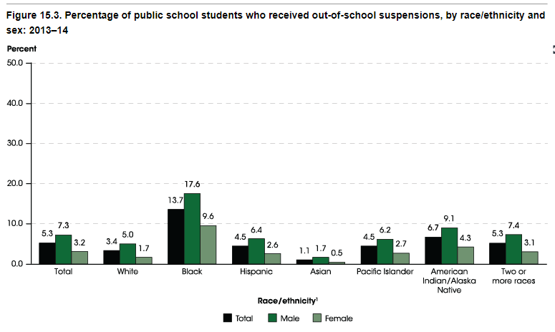
IES:NCES Status and Trends in Education of Racial and Ethnic Groups (2019)
https://nces.ed.gov/programs/raceindicators/indicator_rda.asp
Notes:
Since the 1970s, school suspensions have tripled (Robers, Zhang, Truman, & Snyder, 2012).
An out-of-school suspension is an instance in which a student is temporarily removed from his or her regular school for disciplinary purposes for at least half a day to another setting, such as the home or a behavior center.
U.S. Department of Education reported that In 2013–14, about 2.6 million public school students , which is about 5 percent that received one or more out-of-school suspensions..
And when it is broken down by race we see that the top two racial groups with the highest out-of school suspensions are
*(click animation)*
Black students at almost 14% (13.7 percent)
*(click animation)*
And American Indian/Alaska Native students at 6.7 percent
*(click animation)*
More than twice as many male students (7.3 percent) (click) than female students (3.2 percent) (click) received one or more out-of-school suspensions and was observed for all racial/ethnic groups.
As we just saw, American Indian/Alaska Native students are disciplined at roughly 2 times the rate of their White peers *(click animation)* which affects their levels of engagement, drop out, and academic achievement.
Restorative Justice approaches can serve as an alternative to exclusionary discipline to keep students in school.
Research shows that a restorative justice approach in schools is a viable strategy to changing the school culture from one of social control to one of social engagement (Hulvershorn & Mulholland, 2018; Morrison & Vaandering, 2012).
Because RJ is student centered, it can lead to more equitable academic and social-emotional outcomes; especially for students of color and students with special needs.
IES:NCES Status and Trends in Education of Racial and Ethnic Groups. Indicator 15: Retention, Suspension, and Expulsion (2019) https://nces.ed.gov/programs/raceindicators/indicator_rda.asp

Slide 4
Main Goals of RJ in Schools
Reduce student disengagement that is associated with exclusionary discipline practices (Morrison, 2007).
The student is reintegrated into the school community instead of being isolated from it (González, 2012).
Prioritizes relationships
Address the harm
Repair relationships with those affected
Change students’ behavior by accentuating that a positive school climate is dependent on relationships and sense of belonging over fear of punishment (Todić et al., 2020).
Notes:
The main goal of restorative justice in a school-setting is to reduce student disengagement that is associated with exclusionary discipline practices, like suspension/expulsion and develop educational policies and practices that are more responsive and restorative to the needs and concerns of the school community (Morrison, 2007).
Through restorative justice approaches, the student is reintegrated into the school community instead of being isolated from it (González, 2012).
RJ in schools prioritizes building relationships when responding to problem behavior by addressing the harm done and repairing the relationships between those who have been affected. This requires having a school climate that is safe and supportive.
Research shows that systematic implementation of RJ at the school and district levels, coupled with reform of discipline policies can play a key role in addressing disproportionality in discipline outcomes and is correlated with increased academic achievement,

Slide 5
Study Participants Pseudonyms
Lincoln High School
Grades 9-12
Fairview High School
Grades 7-12
Oak Grove HS
Grades 7-12
Principal: Rob Petty
Assist Principal: Rhett Newsom
SSW: Brett Miller
Students:
Charlie Ross
Elizabeth Frost
Ramona Cruz
Principal: Marty Murphy
Assist Principal: Justin Kelly
SSW intern: Krista Scott
Counselor: Chris Martindale
Students:
Jenica Smith
Stuart Brown
Gretchen White
Principal: Margaret Todd
Assist Principal: Matt Harper
SSW: Stacy Ross
Students:
Veronica Daisy
Jesse Garcia
Talia Waters
Brian Clark
Notes:
This project was approved by the San Juan School Board, the Navajo Nation Human Research Review Board, and the University of Utah IRB.
In October 2019 -We conducted 32, 1-hour semi-structured interview across three high schools about the way discipline in handled in their school and how relationships are fostered.
Students were recruited to participate by school personnel and researchers. Students were told about the study and if interested needed to obtain signed parent permission. All study participants were provided lunch and given a Walmart gift card as a thank you for their time.
All the study participants and schools have been given pseudonyms to protect their identities.
The administration and social workers in this study identify as white. Half the students we interviewed identify as white and the half identify as Native, Latino or mixed race (Latino/native).
Parents were also interviewed but had to be omitted from the study because we did not have a representative sample of parents from all three high schools, and we were unable to collect more due to COVID.

Slide 6
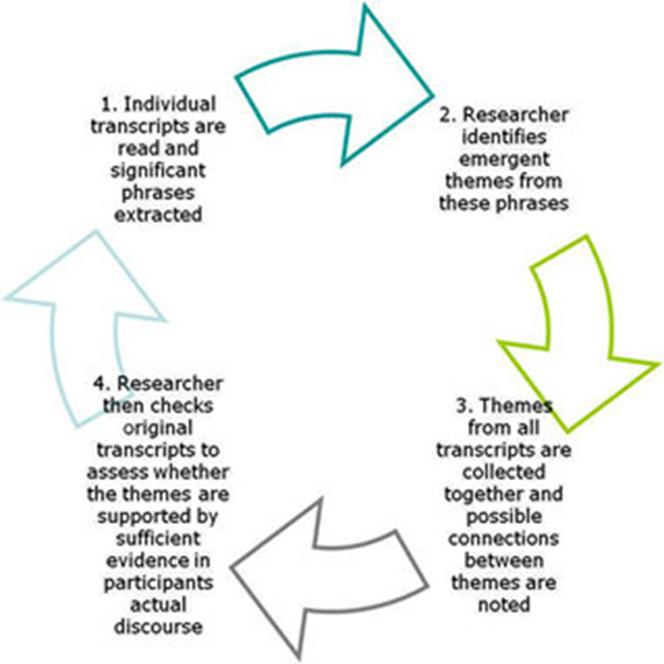
Methods
Research Question:
In what ways does the implementation of Restorative Justice promote positive school-based relationships ?
Thematic and interpretive phenomenological analysis was conducted on 32 semi-structured interviews across three high schools
Notes:
The research question that guided our interview and analysis was
In what ways does the implementation of RJ promote positive school-based relationships?
1. Thematic Analysis- social constructivist –transcripts were read through where emergent codes were developed and refined.
Interpretive Phenomenological (fuh·naa·muh·nuh·laa·juh·kl) Analysis - where we explored how participants made sense of their experiences in school regarding discipline, RJ, and the ability to positively impact school relationships. Each transcript was read and re-read and the initial detailed notes were made by two researchers for every interview.
These notes were used to develop the emerging themes, capturing key elements of the participants responses and experiences. Themes were drawn up into a table and were compared across cases, looking for convergences and divergences. (Smith et al., 2009)

Slide 7
Emergent Themes
Belonging & Diversity
Discipline
School Based Relationships
School Climate
Notes:
The primary themes that emerged from our analysis are : Belonging & diversity, discipline, schoolbased relationships, and school climate.
Belonging & Diversity: To analyze how school communities talked about sense of belonging, the research team asked participants questions regarding their sense of belonging.
Students were asked questions like: Do you feel welcome at school?”, “Is school a place where you feel accepted and respected?”.
School staff were asked a different set of questions that addressed sense of belonging ( “What do you do to make this school a welcoming and safe environment for students of diverse backgrounds?” “How do you observe a teacher’s ability to connect with students?” “Are there things you do so each student and parent is fully engaged in this school?”).
that students reported that if you are not a part of the predominant community and religion, you are less likely to feel accepted. Others report that if you are different, peers will often give you a hard time
A total of ten students spoke to this theme. Additionally, there were 3 School Social Workers, three Principals, and three Assistant Principals who also responded with information regarding sense of belonging.
Discipline- 9 students, 3 SSW, 3 principals and 3 assistant principals. Questions like “What are the school rules?” Have you ever been disciplined for breaking a school rule? What happens when you break the school rules, Who handles discipline, Does everyone receive the same discipline? What is your main goal with student discipline?
To what extent do your student discipline procedures involve others? (teachers, parents, counselors).
Across schools students were divided about whether everyone is treated the same.
Fairview (HS 2) students believe that everyone is treated the same regardless of identities.
Student at Oak Groves (HS3) state that everyone is not treated the same, whether it is because they get in trouble a lot or because they are a “different genre” (popular, smart, etc.).
Three students mentioned that in-school suspension involves completing homework and other assignments and the discipline is largely a black and white issue.
SWs across the schools are involved in discipline in different ways. – one SSW says they attend discipline meeting and help to identify underlying issues. In another school the role of the SSW is to follow up- address root causes not just the behavior alone, and the last SSW says they give support the student and work with them to not get in trouble again.
Assistant Principles- described their jobs as handling student discipline and having SSW address the root causes. They discuss the role of RJ very differently where one says RJ is to address the root problem one sayas RJ is having students write apology letters in in school suspension, and one says RJ is about restoring relationships.
Principals state that the goal to discipline is different.
JS (HS 3) states that the goal is to help students learn to do something different or better next time.
RP (HS 1) states that the goal is to keep students in school.
School Based Relationships: 10 students, 3SSW/1 Counselors, 2 Principals, 3 Assist. Principals
Students- were asked questions like: Do students treat each other well? Do you feel that teachers/principal treat you and your friends/classmates with respect? How would you describe the school culture and climate?
before and after RJ/Peacemaking were implemented?
Do you think RJ/Peacemaking have influenced the school culture and climate? The way students and parent engage in school? If so, how? If not, why not?
Many (Oakgrove) students talked about how they went to school and tried to mind their own business and not get in trouble.
Participants from One (Fairview) school described their school as family and tight bond with one another.
Students at one high school (Lincoln)- talked about being bullied and that there are some teachers/administrators who help and some that do not.
SSW- discuss the importance of connecting with students and finding ways to support students that are facing traumatic events in their lives (past and current).
2 Principals place students at forefront of importance. Building relationship with them is critical.
Assistant Principals – talked more about the important role of the teacher and how their connection with teachers is important and how teachers need more support to do their job.
School Climate – 6 students, 3 SSW, 3 principals, 3 assist principals
Questions like: In school, do you ever talk about the way your actions will affect others? And how to be a good person? Is school a place where you feel accepted and respected? Does your school set clear rules for behavior? What are the attributes of school culture that are important to you? How would you as the leader establish or enhance the school culture for faculty and students?
Students: All but one student report disruptive classrooms or disrespect towards teachers .
Students are recognized for good behavior through many of the school incentive programs .
Students have different experiences with bullying.
SSW: The school climate is benefited by RJ and discussed the importance of teachers and students having positive relationships.
principal and assistant principal) say similar things regarding what they feel is important for school climate which is academics, involvement in extracurricular activities, and teacher relationships. Some admin mention making sure student needs are being met and offering a welcoming entrance to a school.
As part of the general themes form school climate it was implied that when admin is not on board with RJ practices, or does not fully understand the correct way to implement RJ practices in the school, then it is a barrier for school staff to practice RJ.

Slide 8
Key Findings
Inconclusive
Still Early in Implementation- 4th year
Systemic change is still needed
Notes:
Analysis- Our findings were inconclusive about the ways RJ improves school-based relationships.
Our analysis revealed that the implementation of RJ had not yet infiltrated the school culture and climate of any of the high schools we studied. We determined this by the variety of responses made by study participants and whether there was a common language in how they described their school environments as welcoming, positive and inclusive-
Although this is not what we expected, it was not totally surprising because when we interviewed participants, the district was in the fourth year of implementing RJ which is considered the early stages. Research shows us that systemwide change takes multiple years (5-8yrs) to implement and even longer to sustain over time so the fact that there are any movements occurring within the schools after four years is progress.
What we did find, it that the restorative justice philosophy existed in individual people- such as the school social workers/student advocates. They often used a common language, such as getting to the “root cause” of problem.
Lastly, our findings indicate that Systemic change is still needed:
The schools have some awareness that a paradigm shift, from punitive to relational discipline must come from the top down- where the school administration and leadership are driving this change and not the sole responsibility of the school social worker, which was sometimes the case.
To fully implement RJ in schools, the community must also be involved and have buy-in to the paradigm shift.

Slide 9
Thank you.
Comments/Questions?
tkeyes@csusm.edu
Notes:
Thank you. Any comments or questions?

